Slide 1

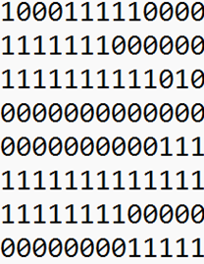
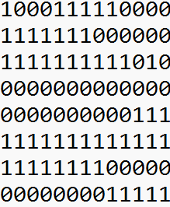



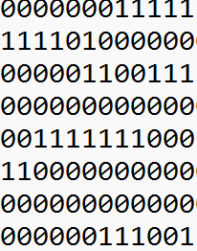



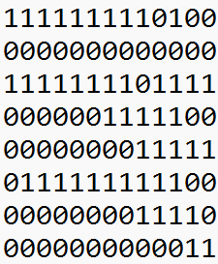






b
c
d
e
a
Encoder
Decoder
Reconstructed Test patterns
Test Patterns
a.
1D Conv Relu(32,3)
b.
1D Conv Relu(16,3)
c.
1D Conv Relu(16,3)
d.
1D Conv Relu(32,3)
Max Pooling(2)
Max Pooling(2)
Upsampling(2)
Upsampling(2)

Slide 2
b
c
d
e
a
Encoder
Decoder
C499 Reconstructed Test patterns
C499 Test Patterns
a.
1D Conv Relu(32,3)
b.
1D Conv Relu(16,3)
c.
1D Conv Relu(16,3)
d.
1D Conv Relu(32,3)
Max Pooling(2)
Max Pooling(2)
Upsampling(2)
Upsampling(2)

Slide 3
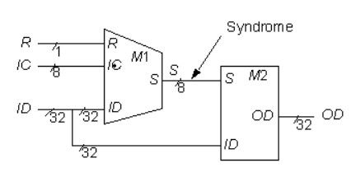
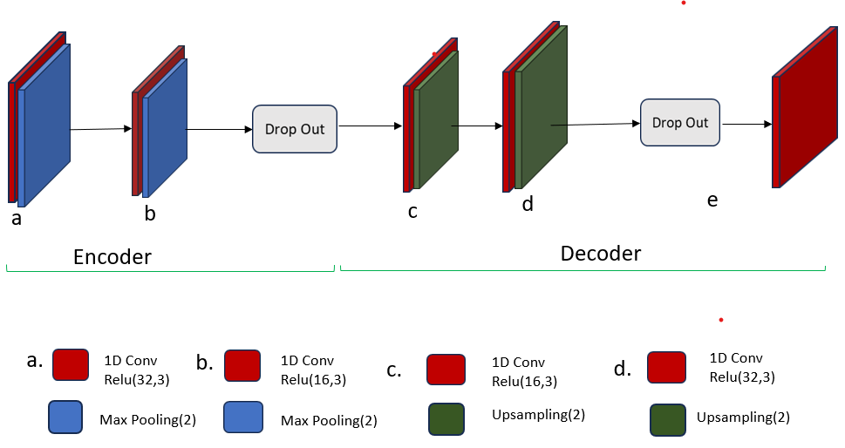
Unsupervised Feature Extraction Through Convolutional Neural Network Based Autoencoder Model
Test Inputs
ATALANTA Tool
Correct outputs
Fig. C499 benchmark circuit
Code
Fault Mask
Classification
Faults

Slide 4
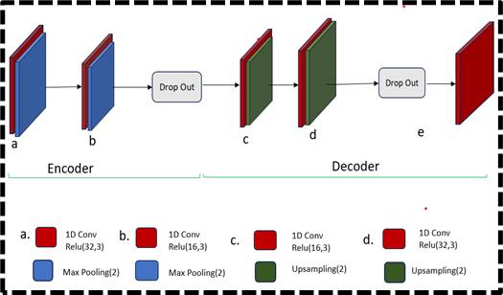
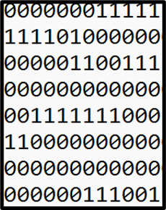
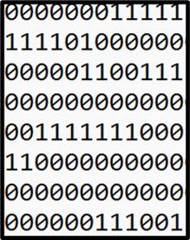
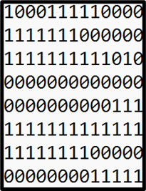
Unsupervised Feature Extraction Through Convolutional Neural Network Based Autoencoder Model
C499 Test Patterns
C499 Reconstructed Test patterns

Slide 5
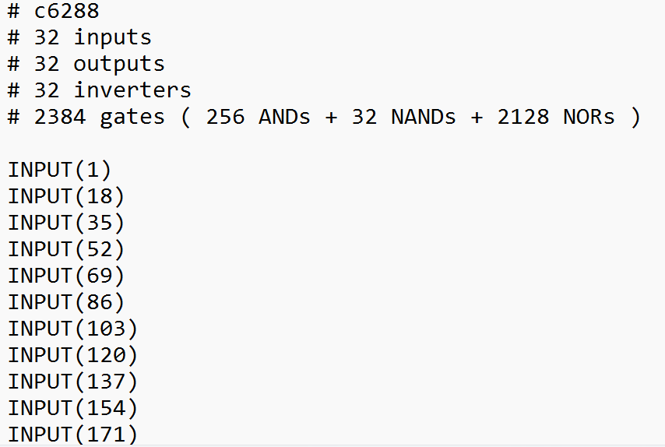
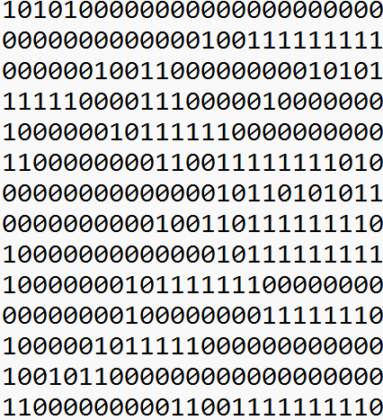
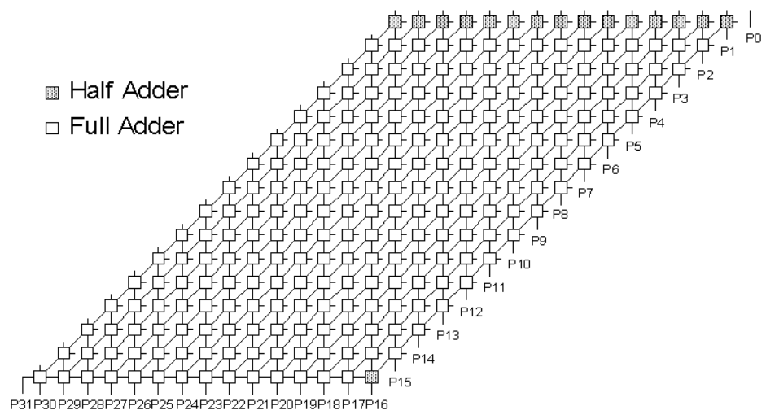

Bench File
ATALANTA Tool
Fig C6288 benchmark circuit

